Slide 1
MiniMarket
Ryan Coslove rmc326

Slide 2
Hypothesis
Null Hypothesis: Items are sold randomly and therefore do no sell together.
Alternative Hypothesis: Items are sold together.

Slide 3
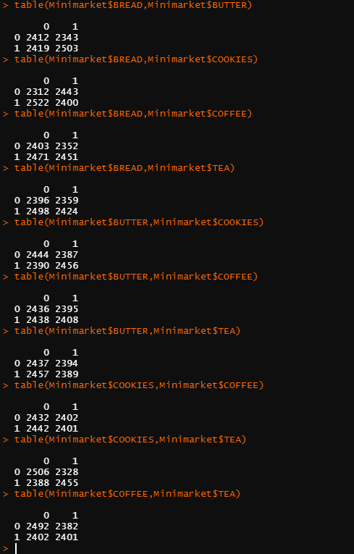
Patterns?
All of the frequency combinations proved to be very similar.
All combinations of 0s and 1s were rather close to each other as seen in the screenshot provided
The largest 1 and 1 combination, was Bread and Butter having 2503 occurrences. (0 and 0 being 2412).
The pattern is likely random. So we will test pairings with permutation test.

Slide 4
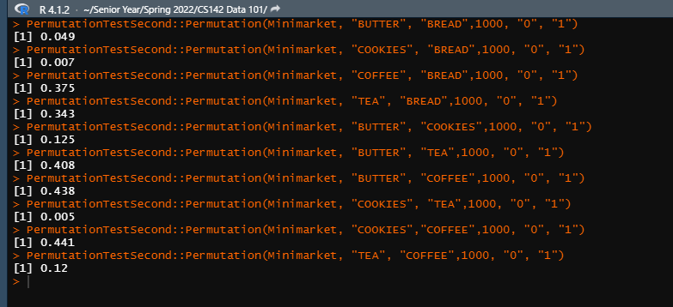
Permutation Tests

Slide 5
Bonferroni Correction
We want to avoid p-value hunting, so we will use the Bonferroni Correction
Bonferroni: 0.05 / 10 comparisons = 0.005
Ideal p-value is <= 0.005

Slide 6

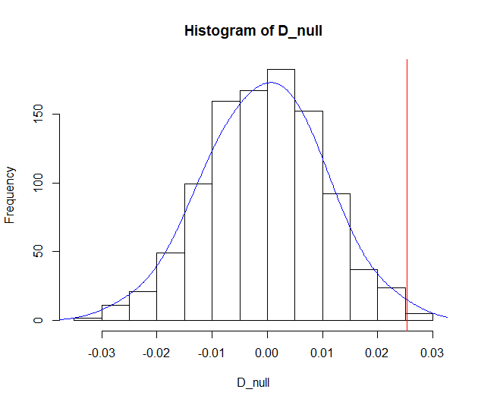
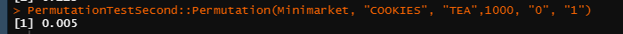
Cookies and Tea
Cookies and Tea resulted in the only combination whose p-value <= 0.005
This allows us to reject the null hypothesis for this pairing of good
This allows us to infer the alternative hypothesis that cookies and tea do sell together is true.

Slide 7
Conclusions
I found that, ultimately, cookies and bread sold together because their p-value was <= 0.005, the ideal p value.
We were able to reject the null hypothesis for this pairing.
The remaining combinations of goods we failed to reject the null hypothesis.

